Slide 1
Deep Learning and Molecular modelling

Slide 2
Describe free energy surface (FES)
Multidimensional Neural Network model
Towards conditional sampling
Stylized Wasserstein Generative Adversarial Network (WGAN)

Slide 3
In Molecular dynamics, trajectory data is produced with classical physics law and miscellaneous potential function that describe the interactions
However, a line (trajectory) is not enough to make a surface.
Notes:
The potential function plays the same role as density functional in DFT
We should extract statistical features out of the trajectory

Slide 4
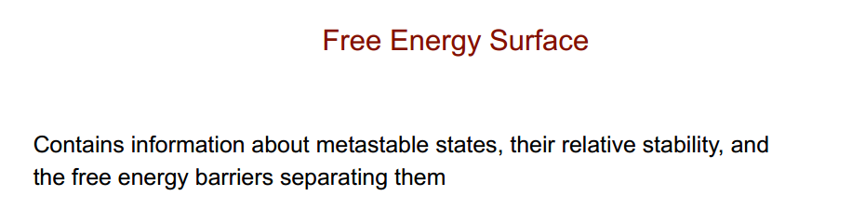
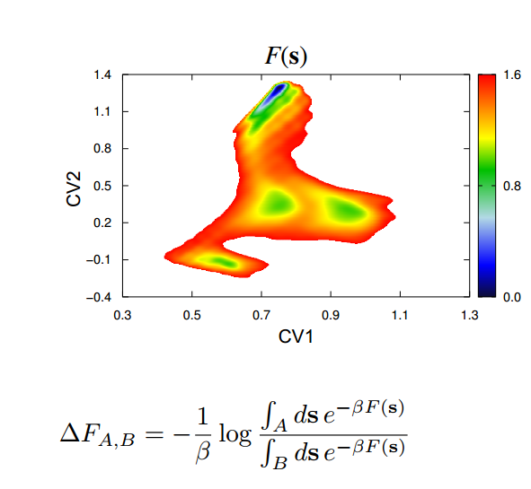
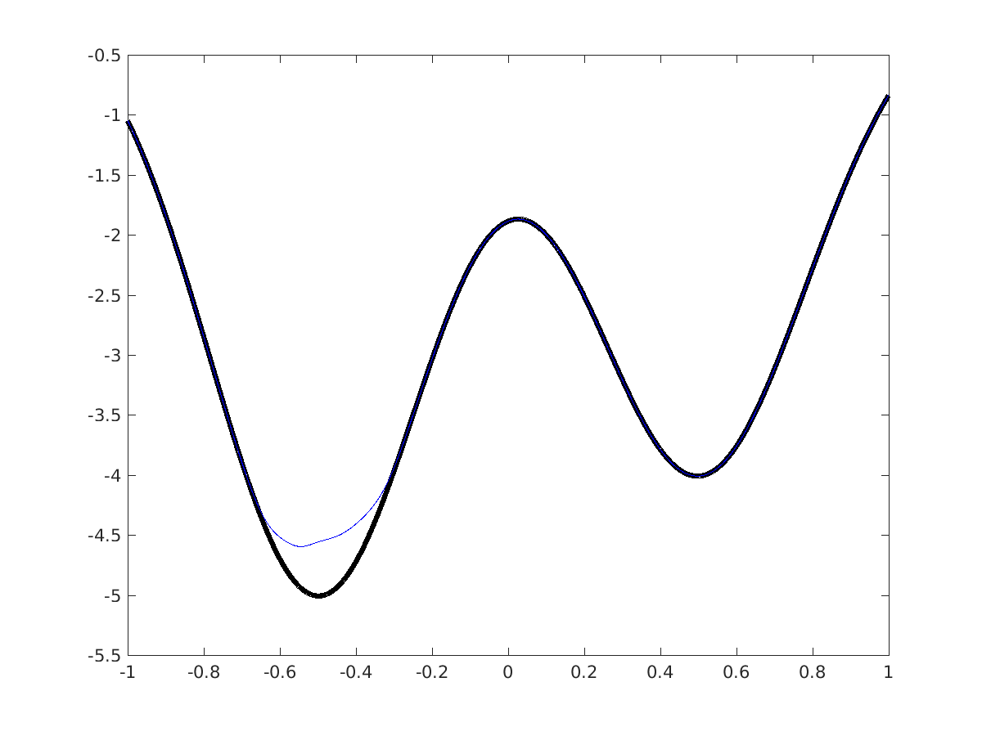
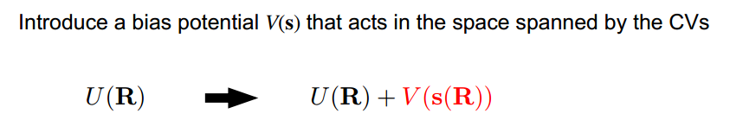
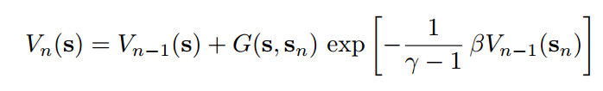
metadynamics
A. Laio, M. Parrinello, PNAS, 99 (20), 2002
J. F. Dama, M. Parrinello, G. A. Voth. Phys. Rev. Lett. 112, 240602 (2014)
Notes:
Metadynamics is to introduce a bias potential, and the model is an explicit parametrized model. Recently they are turning to neutral network model.

Slide 5
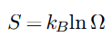
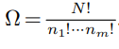
F = U - TS (NVT) G = U + PV – TS (NPT)
What is free energy?
Why it is difficult?
The entropy term needs the allowed states and total states that are both intractable

Slide 6
How to handle this term?
Just like density functional, we make a coordinates functional that is independent of the species of atoms
F = U - TS
F = T * Φ[xyz]
How do we know the functional?
Approximated by Neutral Network

Slide 7
Why Neutral Network?
Universal approximation theorem
How?
Neural Networks can approximate any continuous function, but they do not tell you how
This is where the research starts. It depends on what kind of information (data) you feed for neural network and how you extract the feature (invariance) out of it.
Approximation by Superpositions of a Sigmoidal Function (1989), by G. Cybenko
Universality of Deep Convolutional Neural Networks (2020), by Ding-Xuan Zhou

Slide 8
Target
Find Φ[xyz] approximated by neural network to describe the FES
Data
N atoms simulated with M time steps
Data : (M, N, 3) e.g. (10000, 1024, 3)
Atom species: Na (Al, Mg)
time interval: 2.0 fs

Slide 9
Some Advances in Deep Learning
Extract 3D (xyz) feature is a cutting-edge research area. Autopilot, Radar, etc.
Extract 2D (image) feature is relatively mature, but for our purpose it’s not the case because we have every pixel to count in a sparse matrix
Domain Knowledge
Materials properties are closely related to their structure, one of the best way to characterize materials structure is XRD (1D feature)

Slide 10
Ensemble
Suppose we have 3 oracles
A
50%
B
60%
C
80%
One case is that C will always make mistakes in the rest 20% while A and B stand some chance to be correct
Ensemble could possibly make the best of 3, even better than the best of anyone.
Our oracles will be those examine features extracted from 3D (xyz), 2D (image) and 1D (XRD)

Slide 11
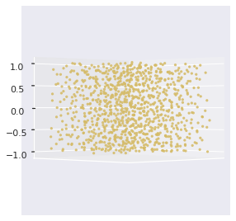
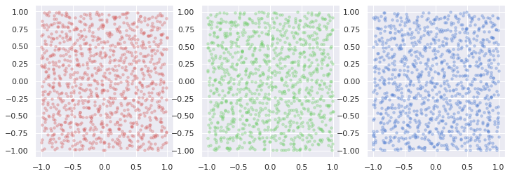
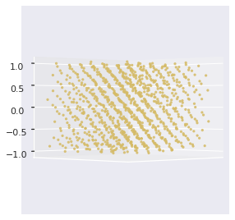
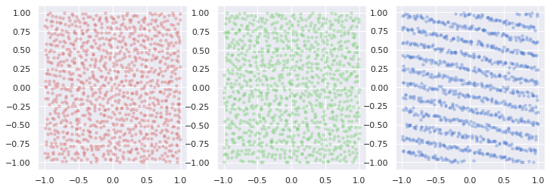
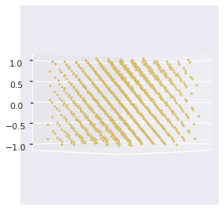
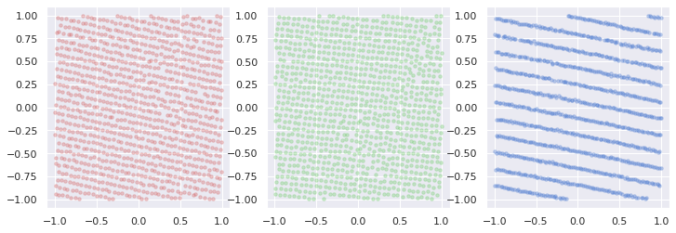
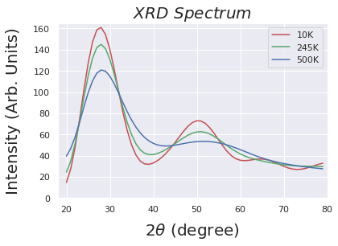
xyz
xy
yz
xz
500K
Visualization
245K
10K
In 500K this peak is flattened but the small curvature still contains information about the structure and property

Slide 12
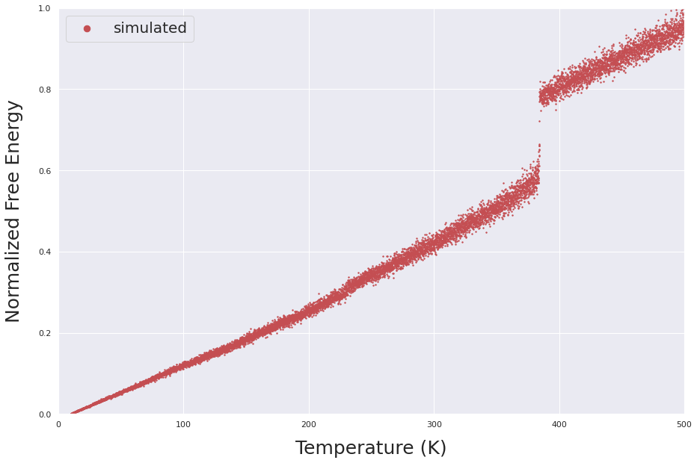
Visualization
Every point in this graph represents a possible configuration. Infinite interval and infinite numbers of such simulation or stochastic path gives us all the possible configurations.
Only with all the configurations will we be able to know the exact entropy.

Slide 13
Model Structure
Discrete version
Concatenation
3D feature
xyz
PointNet
MLP
xy
MLP
FES
MLP
MLP
yz
XRD
xz
MLP
1D feature
2D feature

Slide 14
Continuous & invariance preserved version
SA: Self-Attention
R_{ij} : interatomic distance
Continuity: No pixel, starts from R_{ij}
Permutation invariance: achieved via SA
Roto-translational invariance: achieved via R_{ij}
Concatenation
3D feature
R_{ij} (xyz)
SAx4
MLP
R_{ij} (xy)
SAx4
FES
SAx4
MLP
R_{ij} (yz)
XRD
R_{ij} (xz)
SAx4
1D feature
2D feature

Slide 15
Experiment Setting
Data input
xyz (10000, 1024, 3) (unordered set)
xy, yz, xz (10000, 64, 64, 1) * 3 (ordered grid)
XRD (10000, 60) (spectrum)
FES (10000, 1) (scaler)
Train test split
56.25% (0.75*0.75) training data
18.75% (0.75*0.25) validation data
25% test data
Mean Square Error (MSE) as loss function

Slide 16
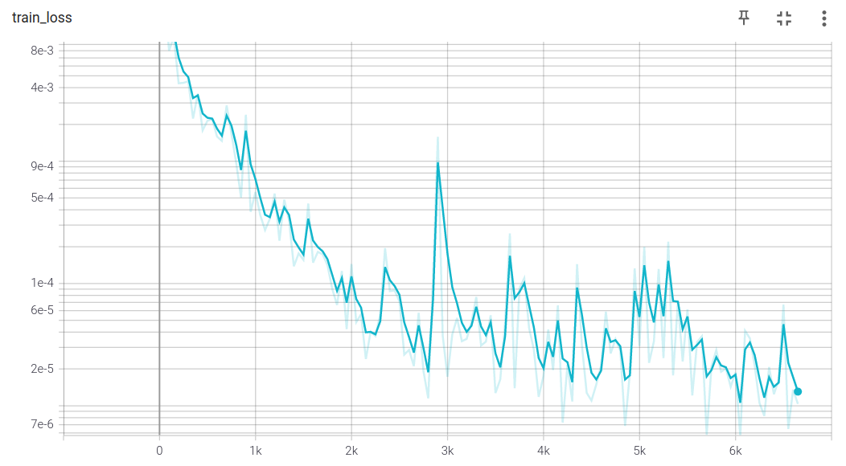
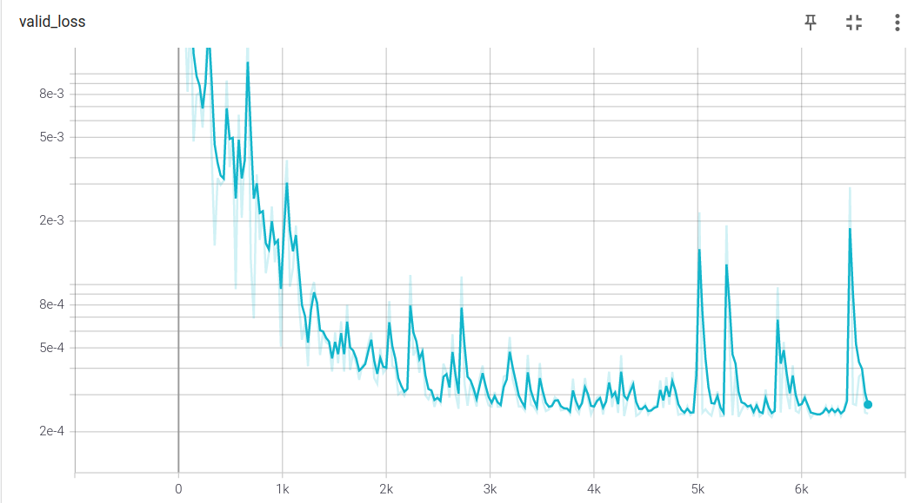
Result (discrete)
MSE on test ~ 9e-5 ~ 0.9eV
Phase transition energy barrier
~ dozens of eVs
Significantly better than the work before In both the accuracy and data efficiency
Improving collective variables: The case of
Crystallization J. Chem. Phys. 150, 094509 (2019)

Slide 17
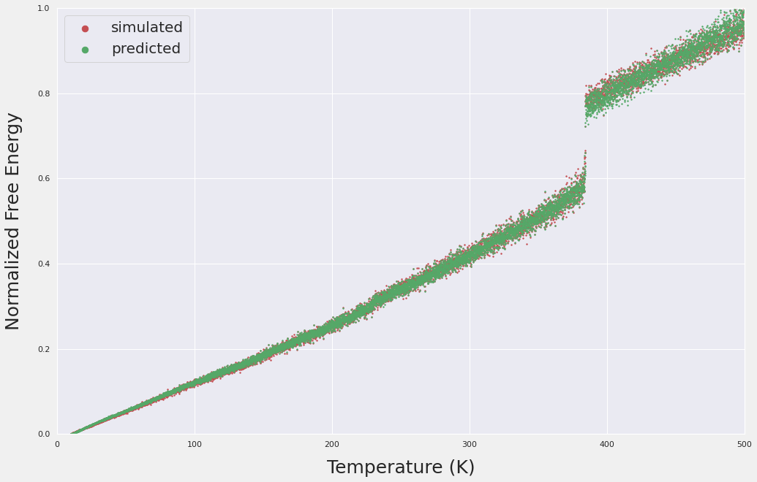
Result (discrete)
phase transition energy barrier

Slide 18
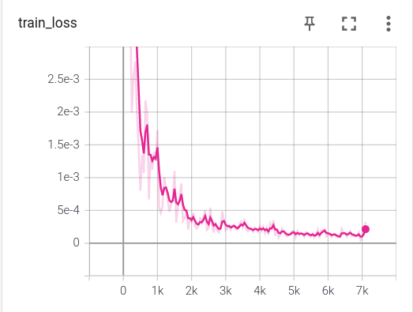
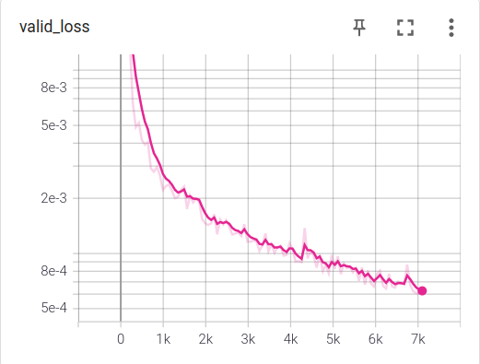
Result (continuous)
MSE on test ~ 1.5e-4
The training curves are much more smoother as we drop the hard border and take R_{ij} instead of xyz coordinates as starting point
The error is still much smaller than any methods before

Slide 19
Conditional Sampling
The model before is a discriminative model
It tells us the free energy given the xyz and function of xyz (Φ[xyz]) near the valid molecular configurations
xyz
xy
yz
xz

Slide 20
Conditional Sampling
A conditional generative model is going to generate the valid molecular configurations (xyz) based on the condition
new xyz
xyz
xy
yz
xz

Slide 21
Conditional Sampling
At every temperature T, because of vibration it’s configuration (xyz) follows a certain distribution. We want to generate such valid configurations based on certain conditions we have.
Why it is super difficult?
Entropy
Although we build a good discriminative model for FES the model will be valid near the simulated data
Data
We don’t know what is enough
Model
The ability to extract features from the data is not good enough

Slide 22
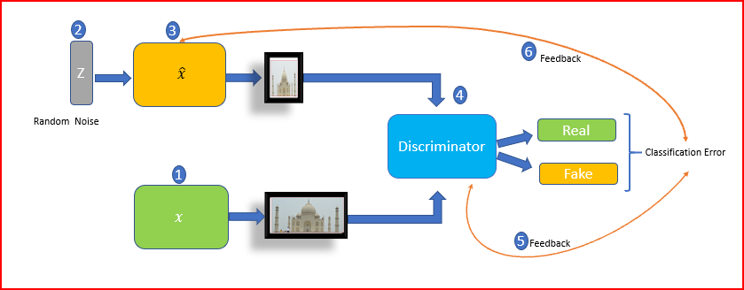
What is GAN?

Slide 23
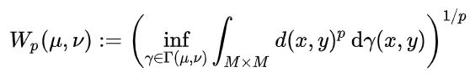
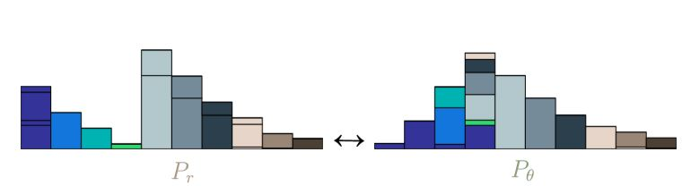
Why Wasserstein?
A well-defined metric for the differences between two distributions
It’s a distance function with explicit physical meaning
Proved to be a significant boost in GAN stabilizing WGAN
https://vincentherrmann.github.io/blog/wasserstein/

Slide 24
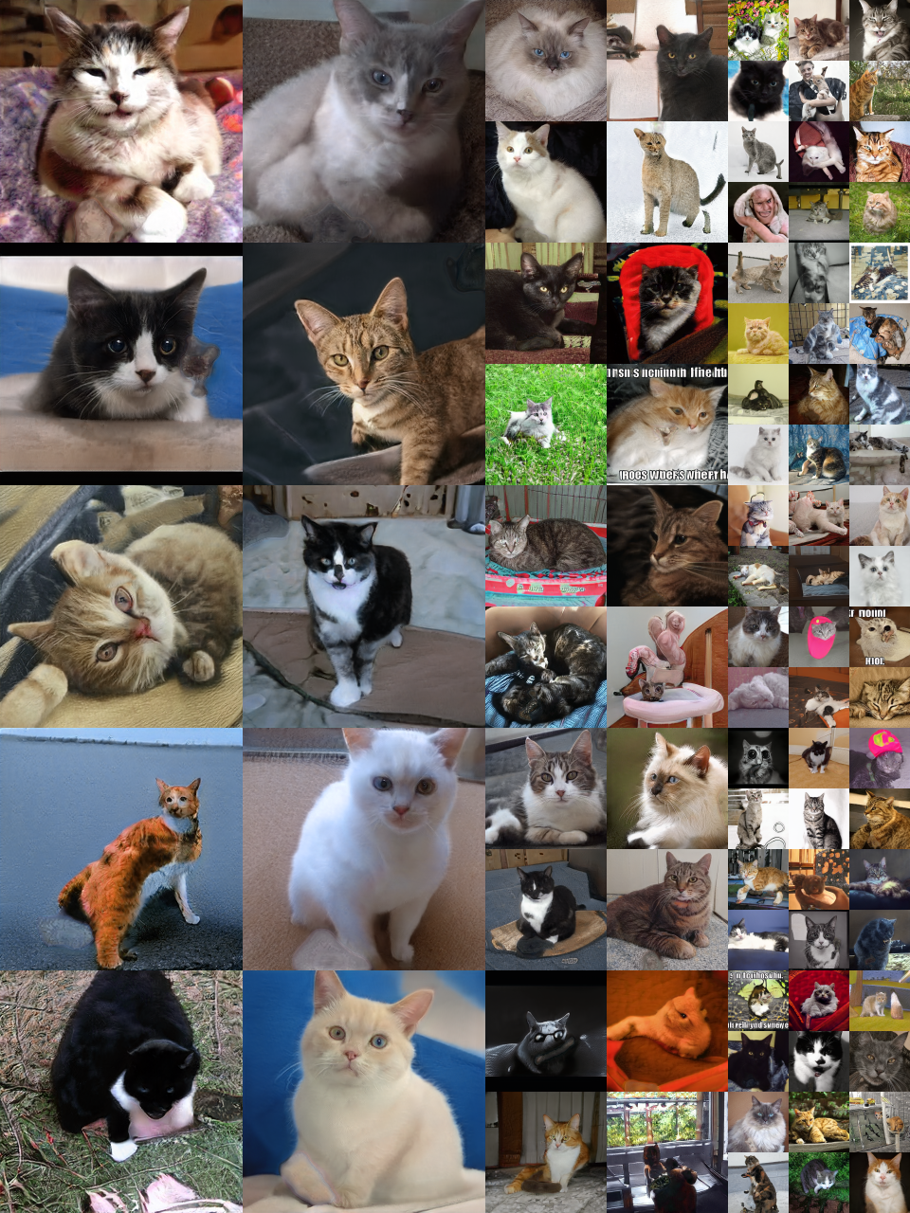
What is style?
StyleGAN encodes the condition (style) as a latent vector that controls the style of the 2D image
Karras, T., Laine, S., & Aila, T. (2019). A style-based generator architecture for generative adversarial networks.

Slide 25
StylizedWGAN in 3D?
Utilize style module (Adaptive Instance Normalization, AdaIN) in WGAN generating 3D coordinates instead of 2D image
There is a fundamental difference between 3D coordinates and 2D image. 2D image has a fixed pixel numbers e.g., an image can be represented as (height, weight, channel) -> (128, 128, 3) while 3D coordinates (natoms, xyz) -> (1024, 3). Although 2D image can be acquired from 3D coordinates via projection, it will introduce either large sparse matrix or reduced accuracy.
It is a very advanced and valuable topic in deep learning and molecular modelling

Slide 26
Physical
constraints
Supervised
learning
Model Structure
3D feature
XRD’
Debye formula
FES ？
Supervised learning
xyz + δ
encode
decode
xyz’
Adversarial training with Wasserstein distance
PointNet
AdaIN Module
projection
XRD
FES
Adversarial training with Wasserstein distance
xy’
yz’
xz’
xyz
encode
PointNet
xy
yz
xz
FES ？

Slide 27
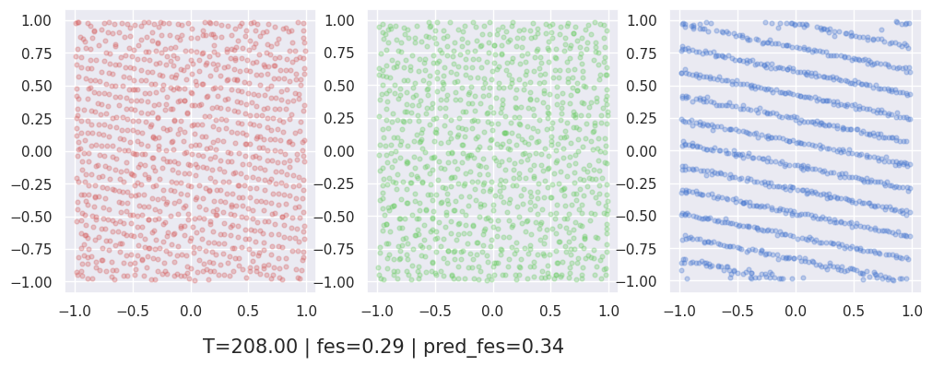
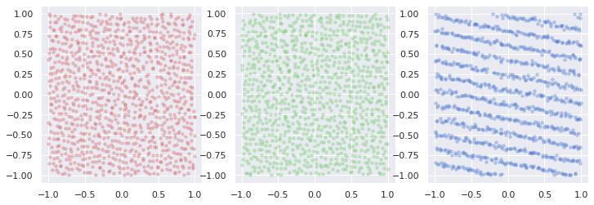
Periodic Boundary Condition ?
Visualization
Generated
Ground truth

Slide 28
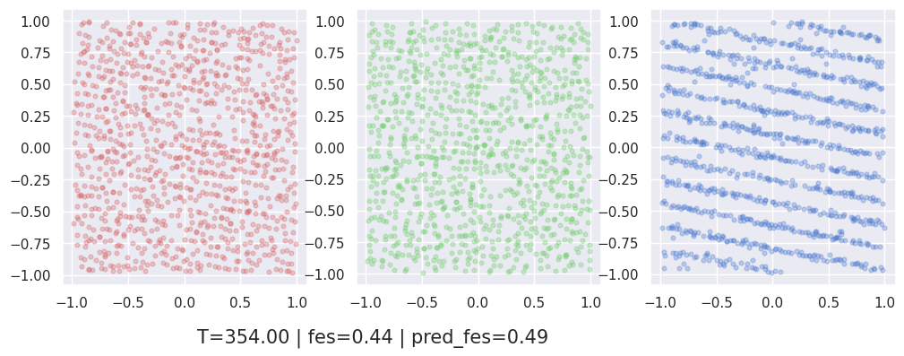

without AdaIN module in 3D encoder
Generated
Ground truth

Slide 29

with AdaIN module in 3D encoder
Generated
Ground truth

Slide 30
Discussion
AdaIN module will rescale the 3d feature according to the condition (style)
If there’s no such module in discriminator, the feature will be across the batch, namely at different temperature samples will be from different distributions
If there is, then it will flatten the differences across the batch and make a one single distribution that minimize the Wasserstein distance. This distance is naturally defined as the minimal energy which will lead to the minimal energy of the material, in this case crystalized states

